Slide 1
E-project
Kidszone

Slide 2
Faculty Name : Sir Abdul Moiz
Cordinator Name : Miss Madiha
Batch Code : 2307f1
Student Name : Muhammad usman , Muhammad haziq

Slide 3
01
Introduction

Slide 4
Introduction
The thirst for learning, upgrading technical skills and applying the concepts in real
life environment at a fast pace is what the industry demands from IT professionals
today. However busy work schedules, far-flung locations, unavailability of convenient
time-slots pose as major barriers when it comes to applying the concepts into
realism. And hence the need to look out for alternative means of implementation in
the form of laddered approach.
The above truly pose as constraints especially for our students too! With their busy
schedules, it is indeed difficult for our students to keep up with the genuine and
constant need for integrated application which can be seen live especially so in the
field of IT education where technology can change on the spur of a moment. Well,
technology does come to our rescue at such times!!
Keeping the above in mind and in tune with our constant endeavour to use
Technology in our training model, we at Aptech have thought of revolutionizing the
way our students learn and implement the concepts using tools themselves by
providing a live and synchronous eProject learning environment!

Slide 5
02

Slide 8
03
Our team

Slide 9
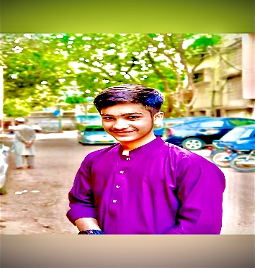


Our Team
Muhammad usman
Muhammad usman

Slide 10
04
Site map

Slide 11
THIS IS HOW OUR SITE MAP LOOKS LIKE:
HOME
CONTACT US
ABOUT US
Classes
teacher

Slide 12
GALLERY
Capital or small abc .
Animal Name .
Fruit or Vegetables Name .
Month or Week Name .
Counting or Table .
Plant Name
Color Name

Slide 13
05
TASKS USER CAN DO:

Slide 14
USERS ARE ABLE TO DO THESE TASKS:
HOME
About
Classes
Teacher
Pages

Slide 15
Kid Zone
Thanks!
Do you have Any questions !
kidzone@gmail.com
+123 456 789
Kidzone.com

